Slide 1
Food Delivery Analytics Dashboard using Power BI
Capstone Project-1 Presentation
Presented by:
Sajeena A
Imarticus Learning

Slide 2

Project Overview
This project focuses on analyzing food delivery business data using Power BI.
The dashboard provides insights into orders, revenue, delivery performance, and customer preferences.
Interactive visualizations help businesses make faster and better decisions.
The project transforms raw delivery data into meaningful business insights.

Slide 3
Problem Statement & Objectives
Problem Statement:
Food delivery businesses generate large amounts of data every day.
Manual analysis of orders, revenue, and delivery performance is difficult and time consuming.
Businesses require a centralized dashboard to monitor performance and customer trends efficiently.
Objectives:
To analyze food delivery data using Power BI.
To create interactive visualizations for better decision-making.
To identify trends in orders, revenue, delivery time, and customer preferences.

Slide 4

Dataset Information
Dataset Used:
• Food Delivery Analytics Dataset
Total Records:
• 5000+ rows of food delivery data
Dataset Contains:
• Order ID
• Order Date
• Customer Name
• City
• Restaurant Name
• Food Category
• Order Amount
• Delivery Time
• Payment Method
• Customer Rating
• Delivery Status

Slide 5
Tools & Technologies
The following tools and technologies were used in this project:
Power BI
Dashboard development and data visualization
Power Query
Data cleaning and transformation
DAX (Data Analysis Expressions)
Creating calculated measures and KPIs
Excel Dataset
Data source for analysis
Visualization Techniques
Bar charts, line charts, donut charts, KPI cards, and slicers

Slide 6
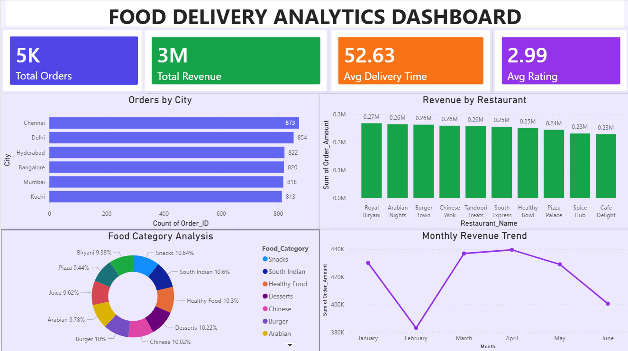
Dashboard Overview The dashboard provides interactive insights into food delivery performance, including revenue trends, customer ratings, delivery efficiency, restaurant performance, and food category analysis.

Slide 7
Key Insights & Outcomes
Key Insights:
Chennai recorded the highest number of food orders.
Royal Biryani generated the highest revenue among restaurants.
Snacks and South Indian categories were among the most popular food types.
Average delivery time was approximately 53 minutes.
Customer ratings remained close to 3 out of 5 on average.
Outcomes:
Improved understanding of customer preferences and restaurant performance.
Interactive dashboard enables faster and better business decision-making.

Slide 8
THANK YOU

